Slide 1
NEET 2025
PHYSICS
Chapter-wise Number of questions
To come in Physics NEET 2025
Ignescent Gurukul
8340353648

Slide 2
Chapter ‒ 1: Unit, measurement & Dimension – [3q]
Topic: → Least Count of Screw gauge
→ Error in measurement of resistance in given circuit (diagram) will be given.
→ Dimension of constant
Ignescent Gurukul
8340353648

Slide 3
Chapter ‒ 2: Kinematics – [3q]
Topic: → Percentage change in momentum.
→ A circular motion question taken R/r from motion under gravity.
→ A simple equation of motion question to find average.
Ignescent Gurukul
8340353648

Slide 4
Chapter ‒ 3: Motion – [2q]
Topic: → Equation involving F = Ma and
→ One question from Banking.
Ignescent Gurukul
8340353648

Slide 5
Chapter ‒ 4: Work, Power, Energy – [3q]
Topic: → Properties related to collision.
→ Work done by non-conservative force.
→ Finding Power
Ignescent Gurukul
8340353648

Slide 6
Chapter ‒ 5: Rotational Motion – [3q]
Topic: → Simple Torque.
→ 1 property question related to angular momentum or Property of rotational motion.
→ Equation of Rotational motion.
Ignescent Gurukul
8340353648

Slide 7
Chapter ‒ 6: Gravitation – [2q]
Topic: → Finding potential energy.
→ Any standard value question.
Ignescent Gurukul
8340353648

Slide 8
Chapter ‒ 7: Solid – [2q]
Topic: → Poisson's Ratio.
→ Elastic Property.
Ignescent Gurukul
8340353648

Slide 9
Chapter ‒ 8: Fluids – [2q]
Topic: → Stoke’s Law.
→ Surface energy question.
Ignescent Gurukul
8340353648

Slide 10
Chapter ‒ 9: TPM – [2q]
Topic: → K equivalent.
→ Newton’s Laws of Cooling.
Ignescent Gurukul
8340353648

Slide 11
Chapter ‒ 10: Thermodynamics – [1q]
Topic: → Work Done.
Ignescent Gurukul
8340353648

Slide 12
Chapter ‒ 11: Kinetic Theory – [2q]
Topic: → rms speed with in line formula.
→ Change in momentum from KT motion.
Ignescent Gurukul
8340353648

Slide 13
Chapter ‒ 12: Oscillation(S.h.m) – [2q]
Topic: → Two spring system.
→ Time Oscillation NCERT.
Ignescent Gurukul
8340353648

Slide 14
Chapter ‒ 13: Waves – [2q]
Topic: → Equation of waves.
→ Intensity of wave with phase difference.
Ignescent Gurukul
8340353648

Slide 15
Chapter ‒ 14: Electrostatics – [5q]
Topic: → Flux.
→ Wire/Plates field.
→ Sphere connection.
→ Capacitance Energy with battery connection.
→ Torque/P.E. on dipole
Ignescent Gurukul
8340353648

Slide 16
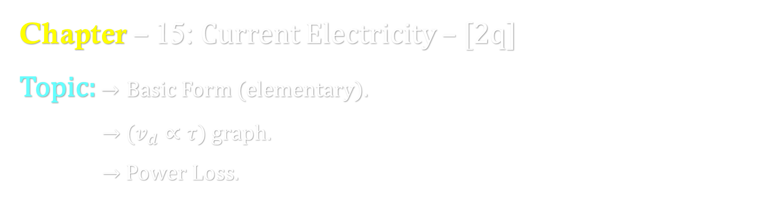
Chapter ‒ 15: Current Electricity – [2q]
Topic: → Basic Form (elementary).
→ ($v_{d}∝τ$) graph.
→ Power Loss.
Ignescent Gurukul
8340353648

Slide 17
Chapter ‒ 16: Magnetism, A.C., EMI– [6q]
Topic: → Magnetic Moment.
→ Properties of magnetic material.
→ Charge motion ratio type.
→ Inductor energy.
→ Any Law Property.
→ EMW Properties use.
Ignescent Gurukul
8340353648

Slide 18
Chapter ‒ 17: Optics – [3q]
Topic: → TIR.
→ Sustained interference property.
→ Width of central mass.
Ignescent Gurukul
8340353648

Slide 19
Chapter ‒ 18: Dual Nature – [2q]
Ignescent Gurukul
8340353648

Slide 20
Chapter ‒ 19: Atoms – [2q]
Ignescent Gurukul
8340353648

Slide 21
Chapter ‒ 20: Nucleus – [2q]
Ignescent Gurukul
8340353648

Slide 22
Chapter ‒ 21: Semiconductor – [2q]
Topic: → Circuit.
→ Waveform.
Ignescent Gurukul
8340353648

